Slide 1
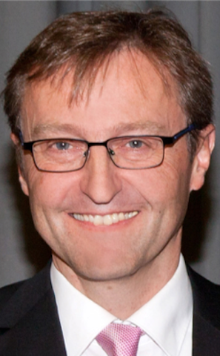
KI – Institute for Artificial Intelligence
Analytic Computing
Machine Learning
2 Classification
Prof. Dr. Steffen Staab
Nadeen Fatallah Osama Mohamed
Daniel Frank Yi Wang Akram Sadat Hosseini Tim Schneider
Rodrigo Lopez
https://www.ki.uni-stuttgart.de/

Slide 2

partially based on slides by
T. Gottron & M. Strohmaier, U. Koblenz-Landau
Florian Lemmerich et al, U. of Würzburg
Now all in different places!
http://west.uni-koblenz.de/en/studium/lehrveranstaltungen/ws1516/machine-learning-and-data-mining
This lecture material for „Machine Learning and Data Mining“ is licensed under a Creative Commons Attribution-ShareAlike 4.0 International License.

Slide 3
Today‘s learning objectives (Monday, April 27, 2020)
Completing this slide deck you should know:
What is Classification?
What does it mean to learn a classifier?
Machine Learning is optimization
In particular: A classifier is learned using optimization
How does the algorithm1-nearest-neighbor work?
kNN

Slide 4
Classification

Slide 5

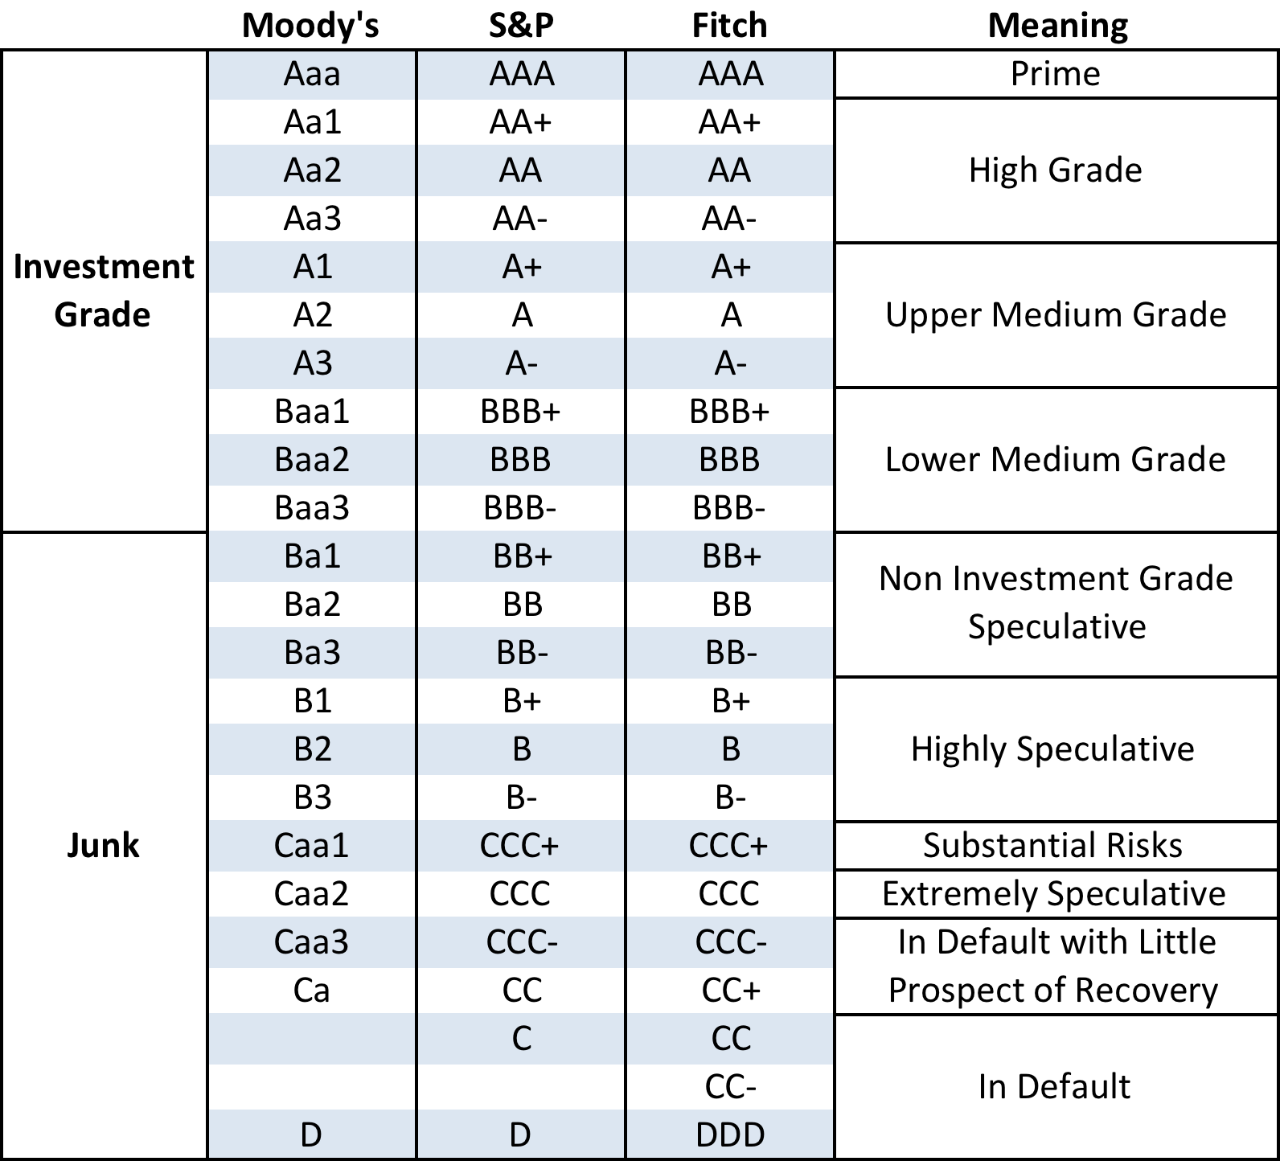
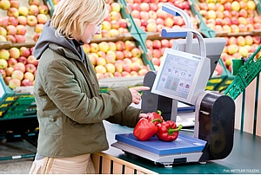

Example use cases for classification

Slide 6





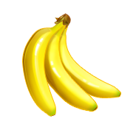






Classification
Classification is a method that assigns labels to object representations
?
apple
banana
$$\text{f}$$
grapes
orange

Slide 7

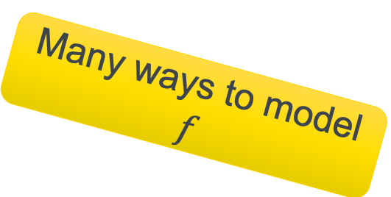
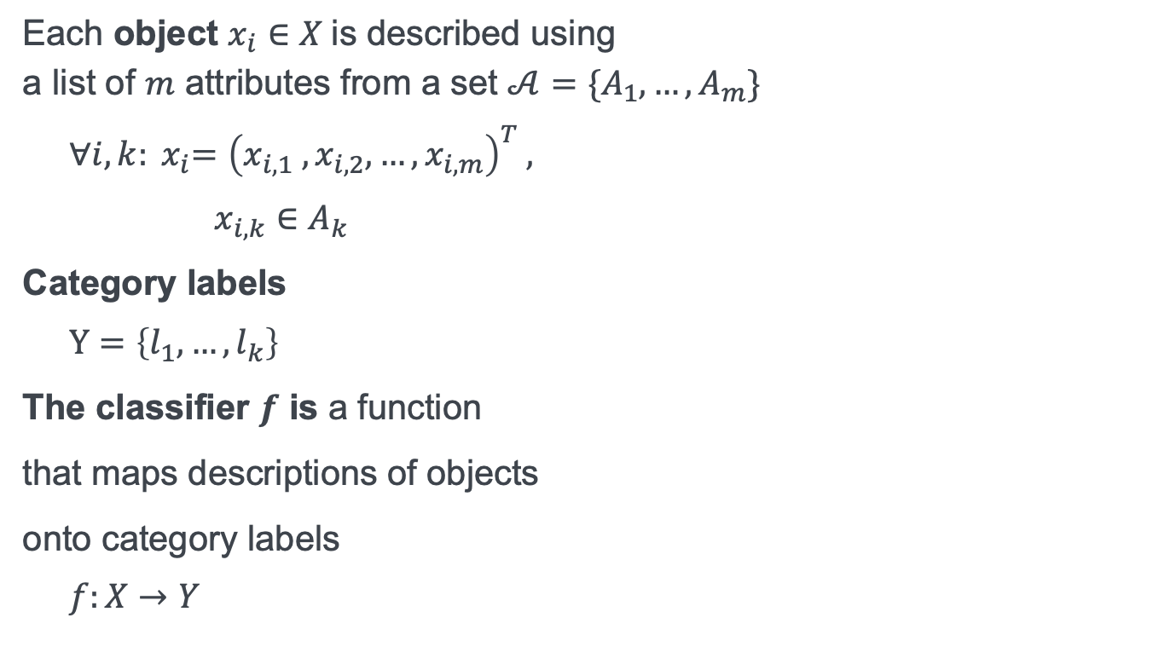
Classifier $f$
Each object $x_{i}∈X$is described using a list of $m$ attributes from a set $𝒜=\{A_{1},…, A_{m}\}$
${∀i,k: x}_{i}={\left(x_{i,1} ,x_{i,2},…, x_{i,m}\right)}^{T}$,
$x_{i,k}∈A_{k}$
Category labels
$Y=\left\{l_{1},…, l_{k}\right\}$
The classifier $f$ is a function
that maps descriptions of objects
onto category labels
$f:X→Y$
(green, round, smooth)
(orange, round, rough)
{apple, banana, grapes, orange}
Many ways to model
$$f$$

Slide 8

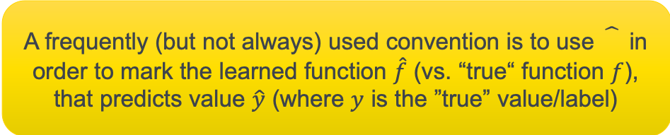
Learning a classifier with pre-classified training data (labeled training data)
Input
Output
apple
banana
orange
grapes
apple
apple
banana
banana
$$\hat{f}$$
grapes
grapes
orange
orange
A frequently (but not always) used convention is to use in order to mark the learned function $\hat{f}$ (vs. “true“ function $f$), that predicts value $\hat{y}$ (where $y$ is the ”true” value/label)
grapes

Slide 9

Learning a classifier with pre-classified training data (labeled training data)
Input
Output
apple
banana
orange
grapes
apple
apple
banana
banana
$$\hat{f}$$
grapes
grapes
orange
orange
grapes

Slide 10

Learning a classifier with pre-classified training data (labeled training data)
apple
banana
$$F$$
orange
grapes
apple
apple
banana
banana
$$\hat{f}$$
grapes
grapes
orange
orange
grapes

Slide 11

Families of functions $F=\{f|…\}$
$$F$$
Which families of functions do you know?
$$∈$$
$$\hat{f}$$

Slide 12


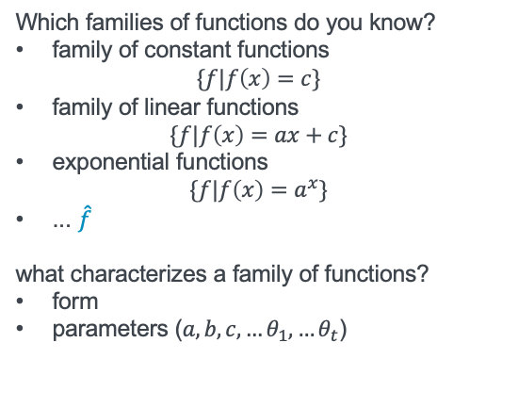
Families of functions $Γ=\{f|…\}$
$$F$$
Which families of functions do you know?
family of constant functions $\{f|f\left(x\right)=c\}$
family of linear functions
$$\{f|f\left(x\right)=ax+c\}$$
exponential functions
$$\{f|f\left(x\right)=a^{x}\}$$
... ${\hat{f}}_{ }$
what characterizes a family of functions?
form
parameters ($a,b,c,…θ_{1},…θ_{t}$)
$$∈$$
$$\hat{f_{θ}}$$
Notes:
Which families of functions do you know?
family of constant functions $\{f|f\left(x\right)=c\}$
family of linear functions
$\{f|f\left(x\right)=ax+c\}$
exponential functions
$\{f|f\left(x\right)=a^{x}\}$
...
what characterizes a family of functions?
form
parameters ($a,b,c,…$)

Slide 13
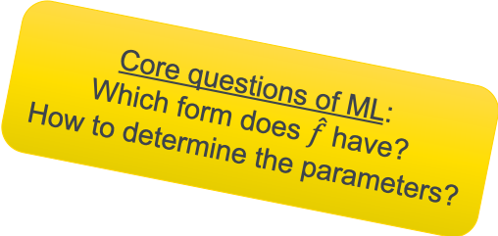
Learning a classifier with pre-classified training data (labelled training data)
apple
ML
banana
$$F$$
orange
grapes
apple
learn
$$\hat{f_{θ}}$$
banana
apple
banana
grapes
grapes
orange
orange
Core questions of ML:
Which form does $\hat{f}$ have?
How to determine the parameters?
grapes

Slide 14
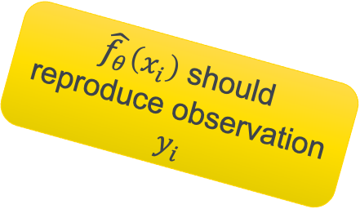
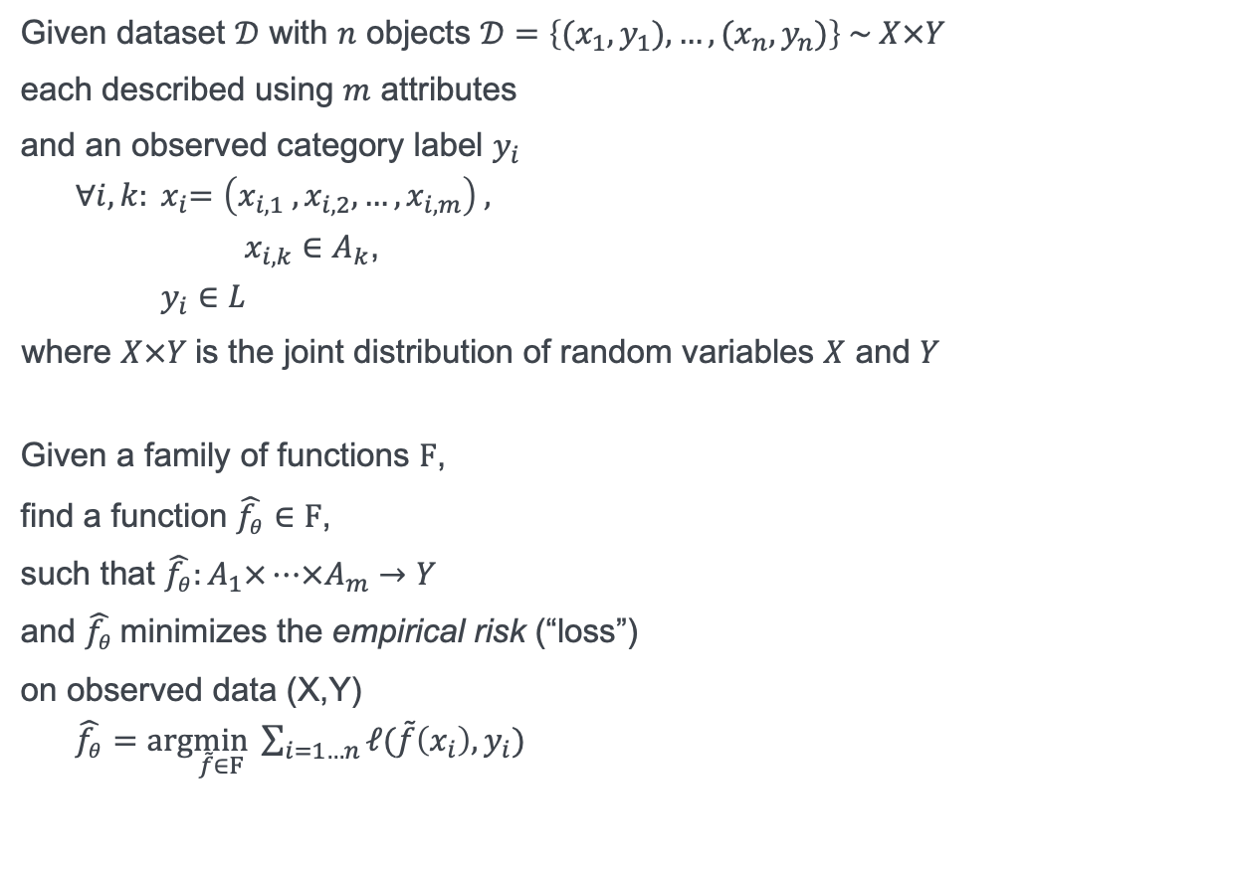
Defining the task of learning a classifier
Given dataset $𝒟$ with $n$ objects $𝒟=\left\{(x_{1},y_{1}),…, (x_{n},y_{n})\right\} \sim X×Y$
each described using $m$ attributes
and an observed category label $y_{i}$
${∀i,k: x}_{i}=\left(x_{i,1} ,x_{i,2},…, x_{i,m}\right)$,
$x_{i,k}∈A_{k}$,
$y_{i}∈L$
where $X×Y$is the joint distribution of random variables $X$ and $Y$
Given a family of functions $F$,
find a function $\hat{f_{θ}}∈F$,
such that $\hat{f_{θ}}:A_{1}×…×A_{m}→Y$
and $\hat{f_{θ}}$minimizes the empirical risk (“loss”)
on observed data (X,Y)
$\hat{f_{θ}}=arg\min_{\tilde{f}∈F} \sum_{i=1…n}{ℓ(\tilde{f}\left(x_{i}\right),y_{i})}{}$
apple
(green, round, smooth)
(orange, round, rough)
orange
$\hat{f_{θ}}\left(x_{i}\right)$ should reproduce observation $y_{i}$

Slide 15
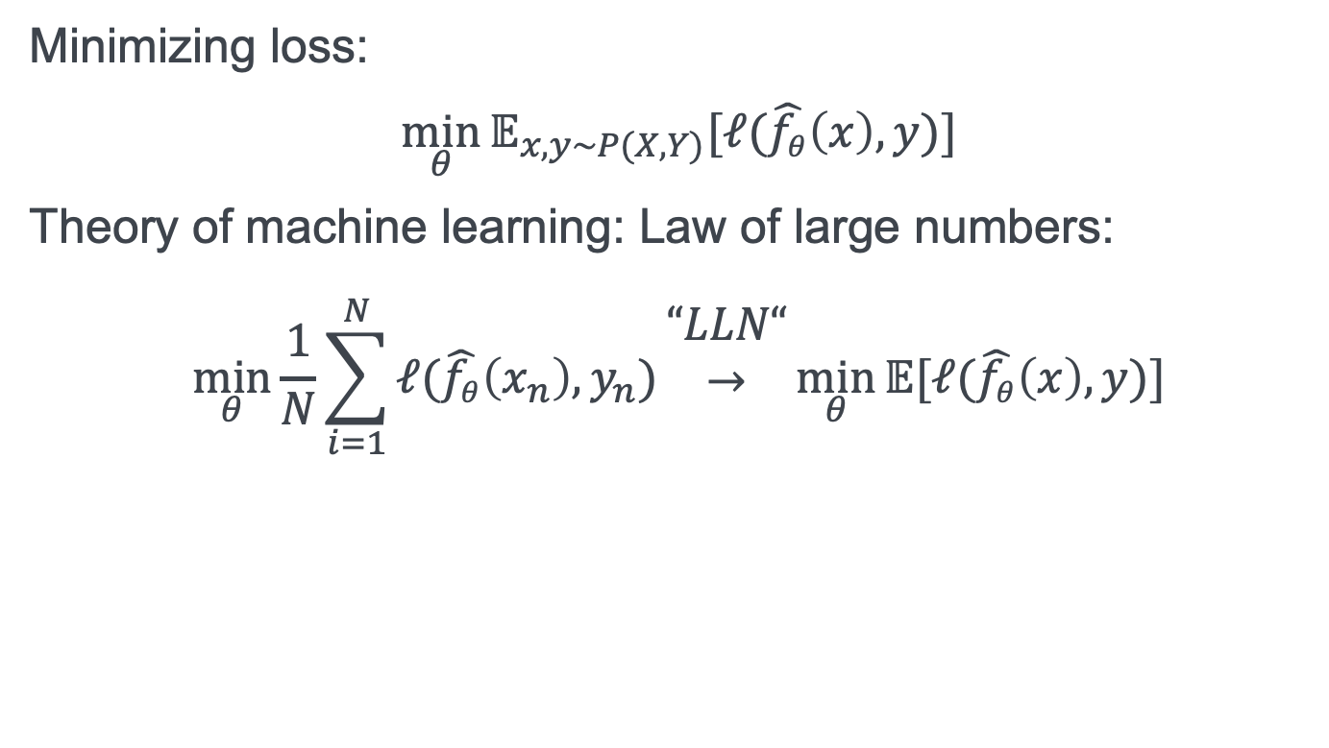
Empirical risk minimization and overfitting
Minimizing loss:
$$\min_{θ}{𝔼_{x,y\sim P(X,Y)}[ℓ(\hat{f_{θ}}\left(x\right),y)]}$$
Theory of machine learning: Law of large numbers:
$$\min_{θ}{\frac{1}{N}\sum_{i=1}^{N}{ℓ(\hat{f_{θ}}\left(x_{n}\right),y_{n})}}\begin{matrix}“LLN“ \\ → \\ \end{matrix}\min_{θ}{𝔼[ℓ(\hat{f_{θ}}\left(x\right),y)]}$$

Slide 16
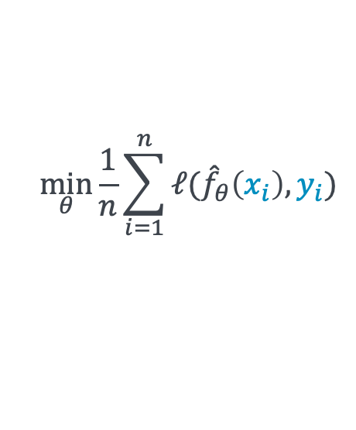
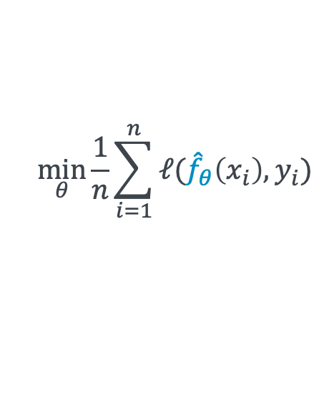
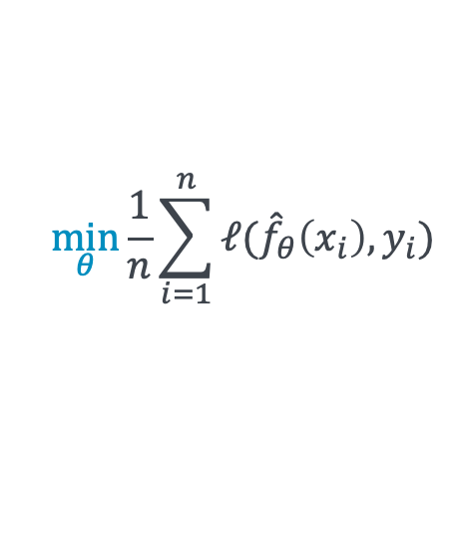
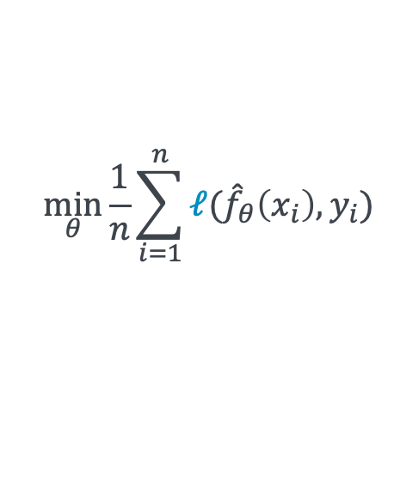
Viewing machine learning as empirical risk minimization
Designing models:
Choosing/augmenting data:
$$\min_{θ}{\frac{1}{n}\sum_{i=1}^{n}{ℓ({\hat{f}}_{θ}\left(x_{i}\right),y_{i})}}$$
$$\min_{θ}{\frac{1}{n}\sum_{i=1}^{n}{ℓ({\hat{f}}_{θ}\left(x_{i}\right),y_{i})}}$$
Designing loss function:
Designing optimization methods:
$$\min_{θ}{\frac{1}{n}\sum_{i=1}^{n}{ℓ({\hat{f}}_{θ}\left(x_{i}\right),y_{i})}}$$
$$\min_{θ}{\frac{1}{n}\sum_{i=1}^{n}{ℓ({\hat{f}}_{θ}\left(x_{i}\right),y_{i})}}$$

Slide 17
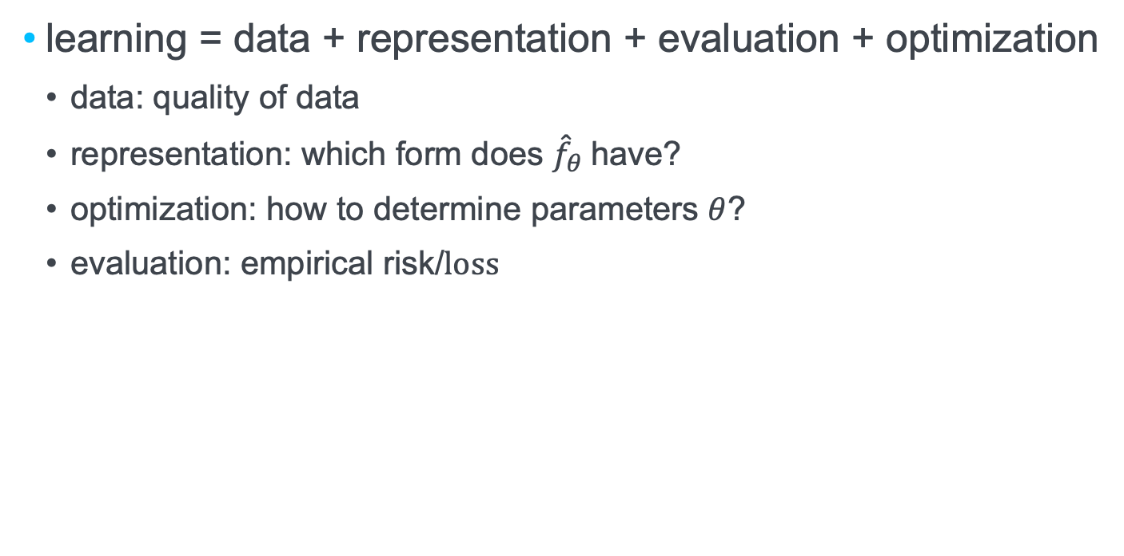
A Few Useful Things to Know about Machine Learning
learning = data + representation + evaluation + optimization
data: quality of data
representation: which form does ${\hat{f}}_{θ}$have?
optimization: how to determine parameters $θ$?
evaluation: empirical risk/$loss$

Slide 18
1-nearest-neighbor

Slide 19
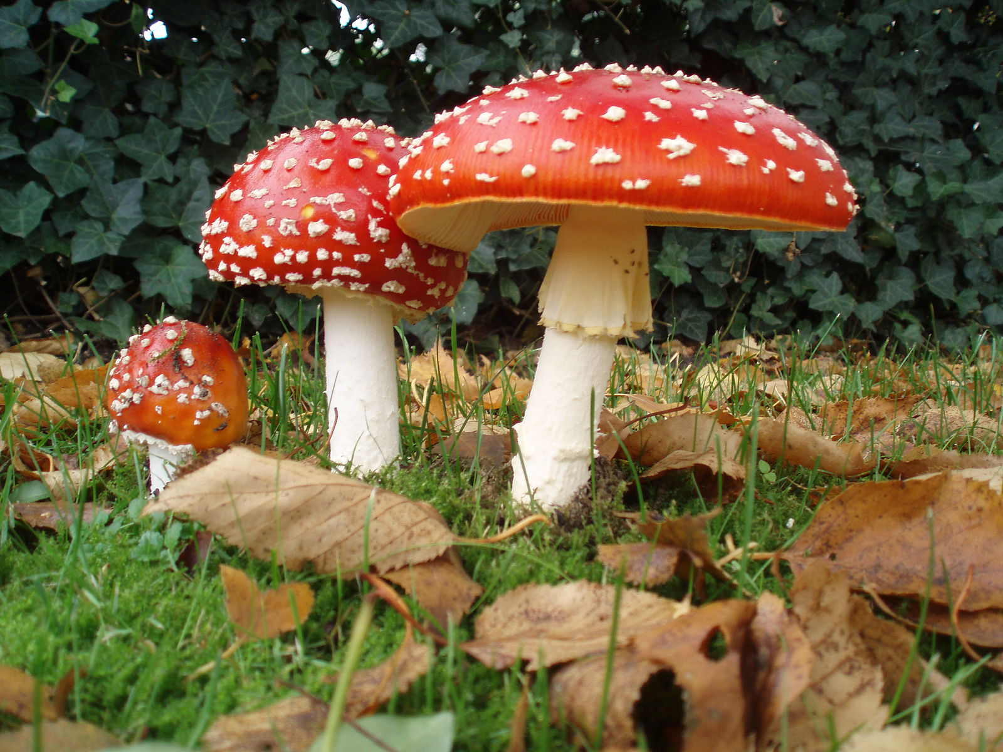
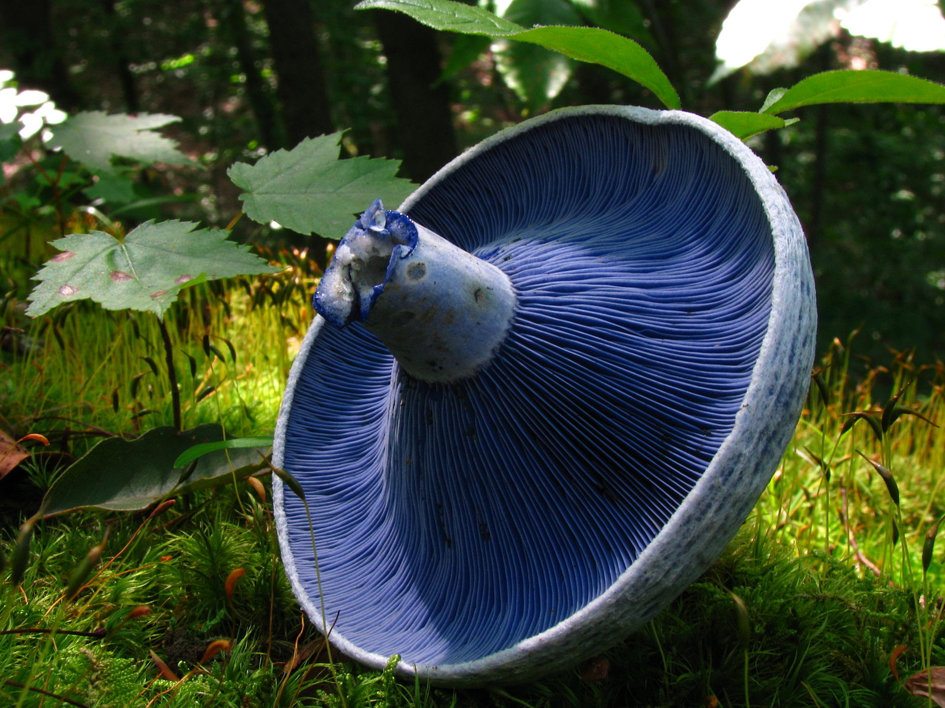
Mushroom dataset (subset)
Example
cap
gills
???
???

Slide 20
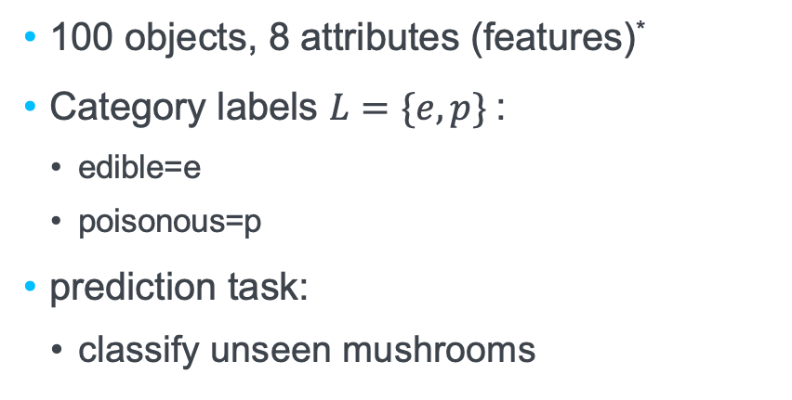

Mushroom dataset (subset)
Example
100 objects, 8 attributes (features)*
Category labels $L=\{e,p\}$:
edible=e
poisonous=p
prediction task:
classify unseen mushrooms
$${ \hat{f}}_{θ}$$
cap-shape | cap-surface | cap-color | bruises | gill-spacing | gill-size | gill-color | habitat
bell=b convex=x flat=f sunken=s | fibrous=f scaly=y smooth=s | brown=n gray=g white=w yellow=y | bruises=t no=f | close=c crowded=w | broad=b narrow=n | black=k brown=n gray=g pink=p white=w | grasses=g meadows=m paths=p urban=u woods=d
* Original dataset contains more features and also more values for the features shown here
http://archive.ics.uci.edu/ml/datasets/Mushroom

Slide 21
The first 4 entries of the mushroom data set
p,x,s,n,t,p,f,c,n,k,e,e,s,s,w,w,p,w,o,p,k,s,u
e,b,s,w,t,l,f,c,b,n,e,c,s,s,w,w,p,w,o,p,n,n,m
p,x,y,w,t,p,f,c,n,n,e,e,s,s,w,w,p,w,o,p,k,s,u
e,x,s,y,t,a,f,c,b,k,e,c,s,s,w,w,p,w,o,p,n,n,g
bell shaped yes (b), no (x)
black gills yes (k), no (n)
edible/ poisonous
Notes:
1. cap-shape: bell=b,conical=c,convex=x,flat=f, knobbed=k,sunken=s 2. cap-surface: fibrous=f,grooves=g,scaly=y,smooth=s 3. cap-color: brown=n,buff=b,cinnamon=c,gray=g,green=r, pink=p,purple=u,red=e,white=w,yellow=y 4. bruises?: bruises=t,no=f 5. odor: almond=a,anise=l,creosote=c,fishy=y,foul=f, musty=m,none=n,pungent=p,spicy=s 6. gill-attachment: attached=a,descending=d,free=f,notched=n 7. gill-spacing: close=c,crowded=w,distant=d 8. gill-size: broad=b,narrow=n 9. gill-color: black=k,brown=n,buff=b,chocolate=h,gray=g, green=r,orange=o,pink=p,purple=u,red=e, white=w,yellow=y

Slide 22
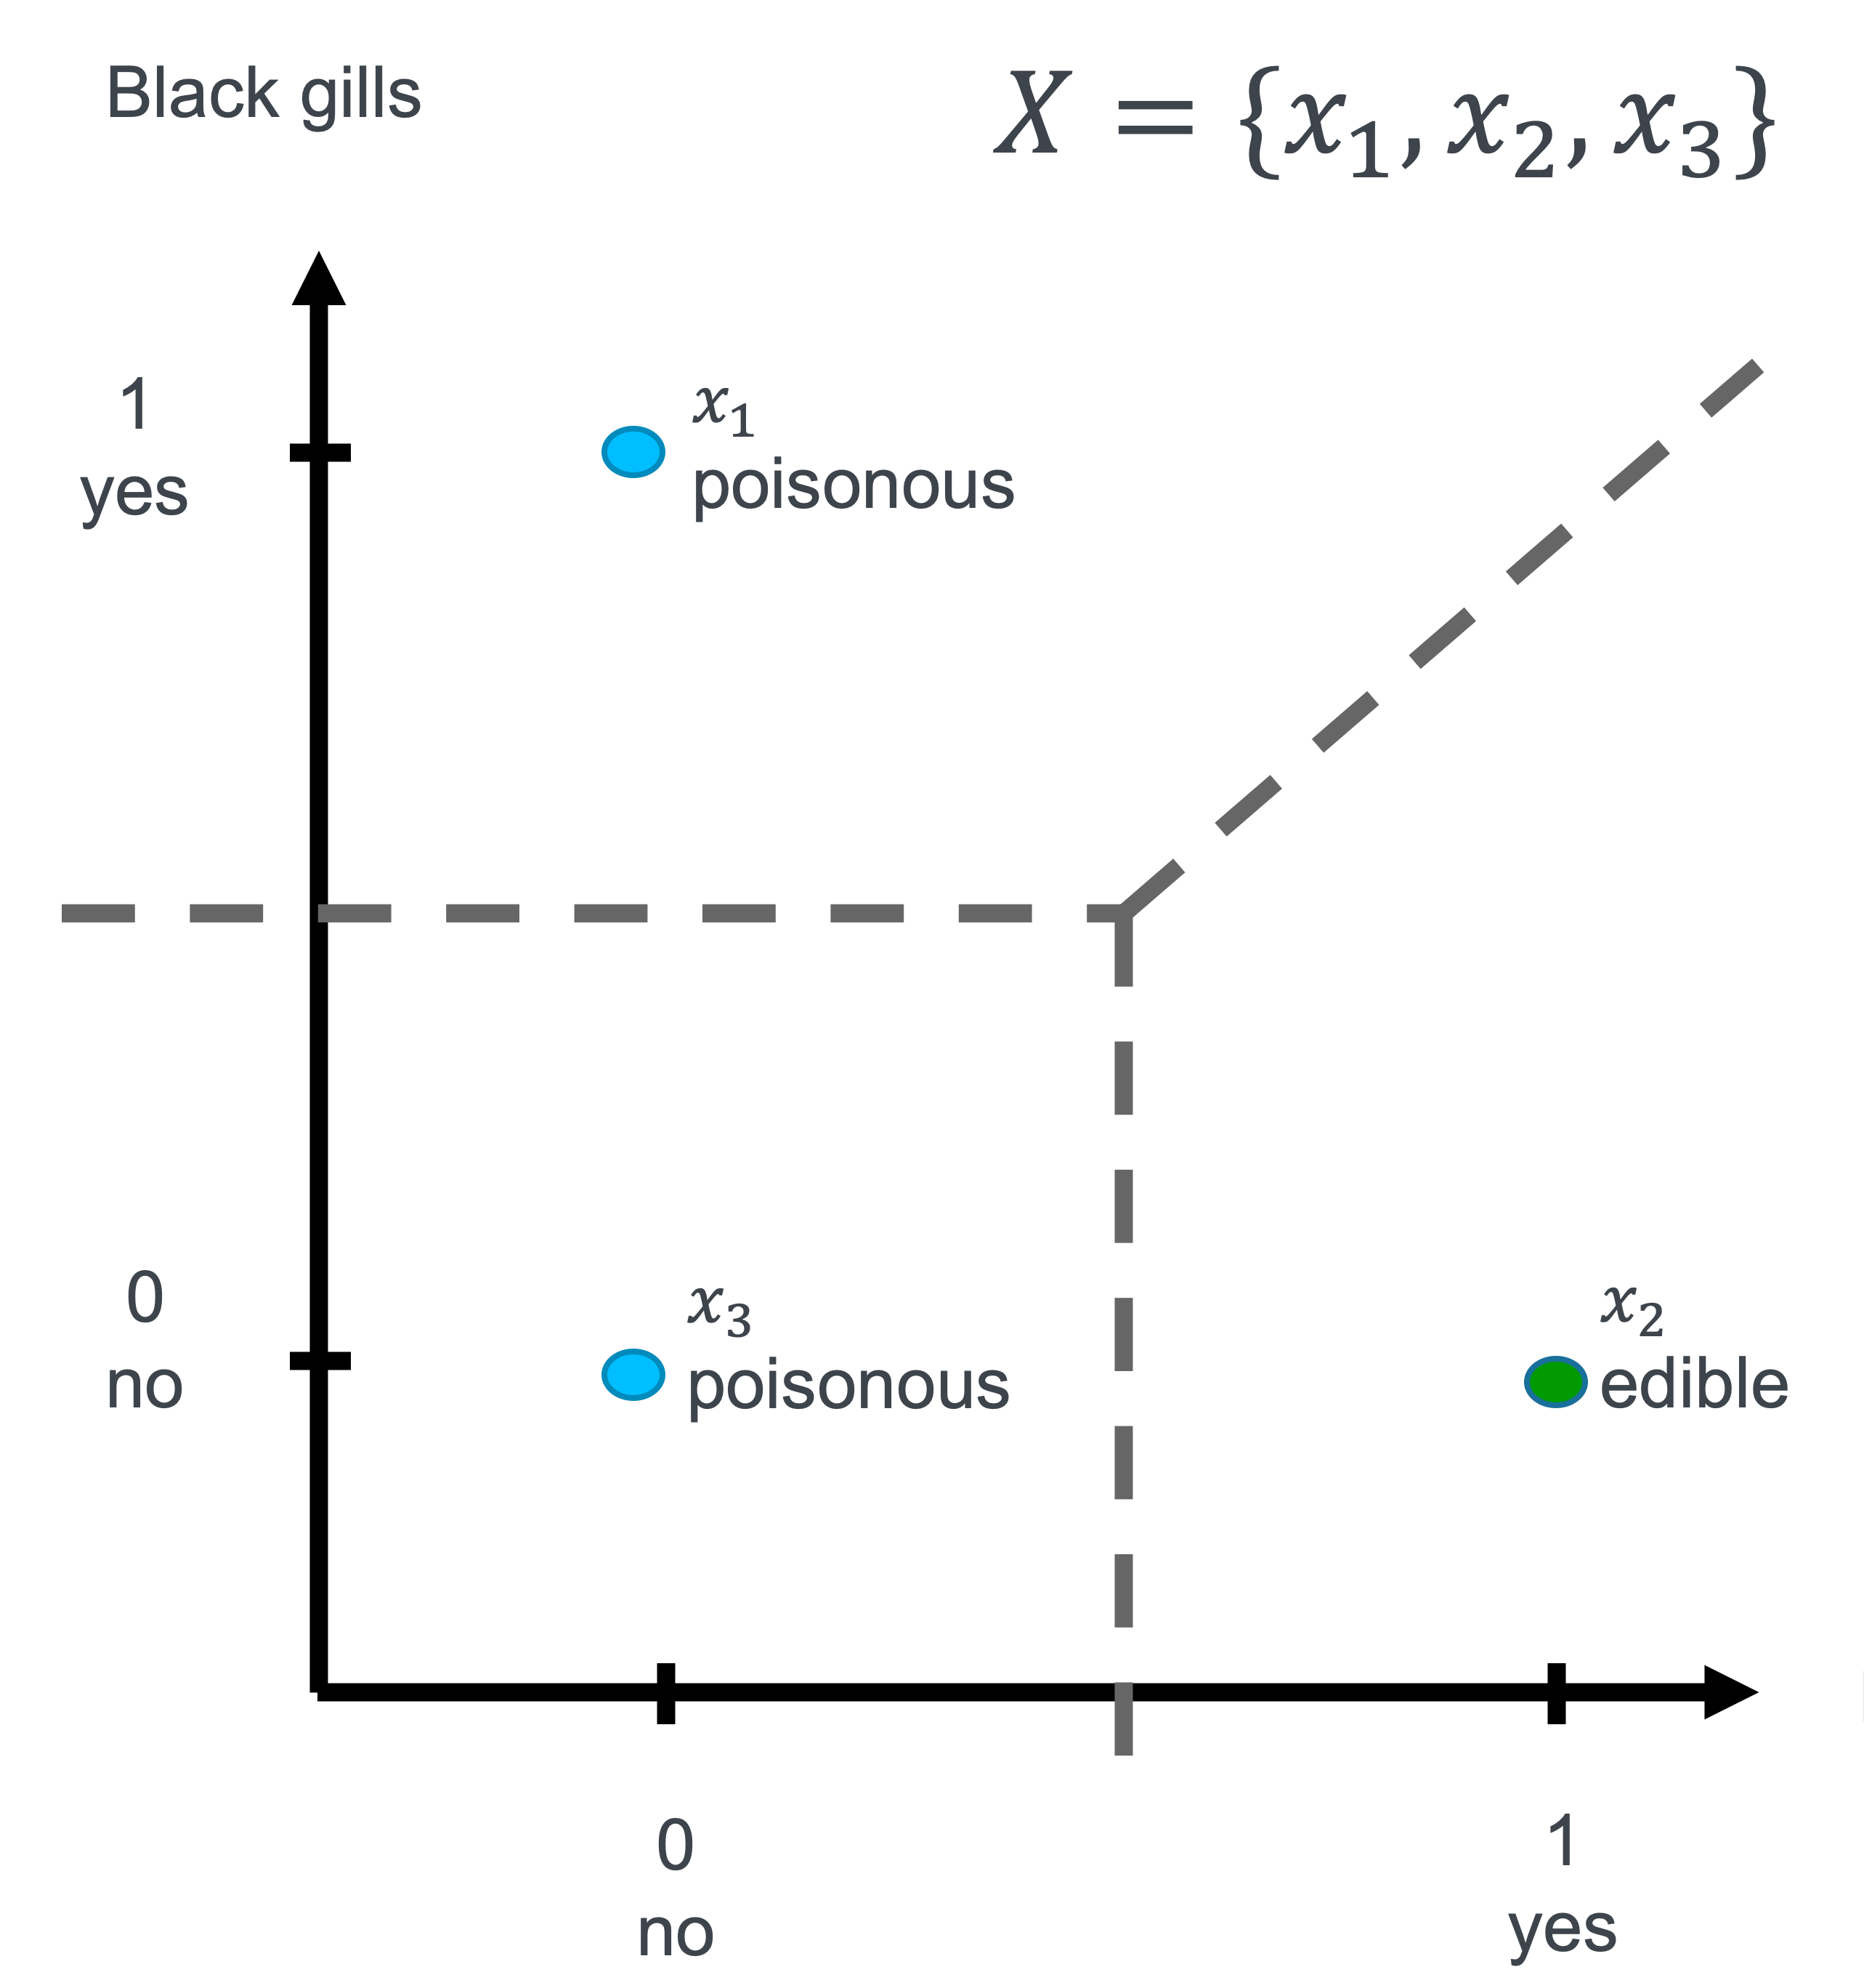
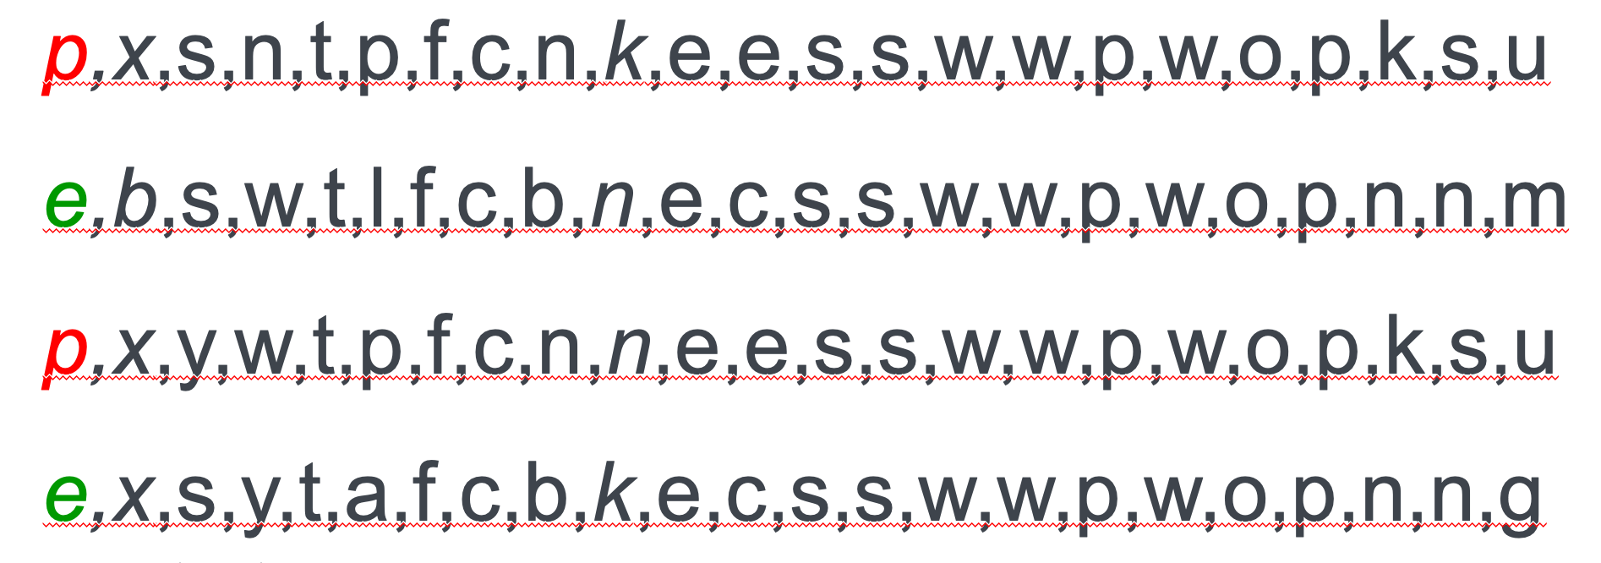
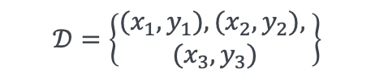
Data Preprocessing
In this example: from CSV to suitable vector representation
$$𝒟=\left\{\begin{aligned}(x_{1},y_{1}),(x_{2},y_{2}), \\ (x_{3},y_{3})\end{aligned}\right\}$$

Slide 23
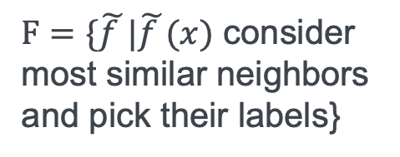
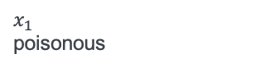
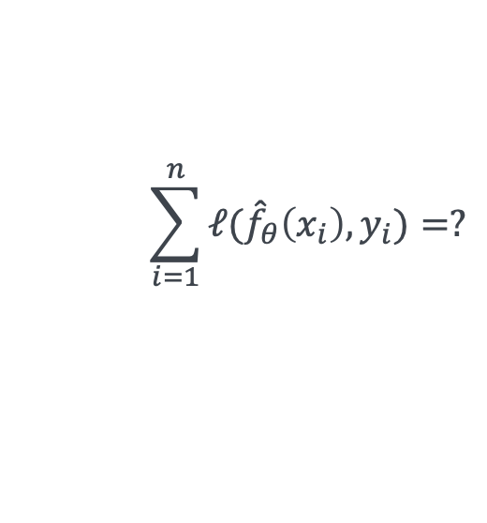
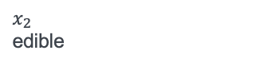
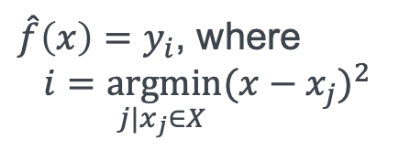
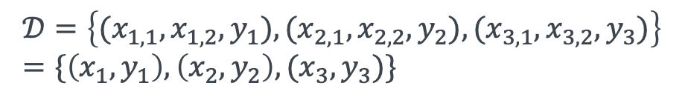
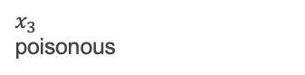

1-nearest-neighbor (1-NN): Lazy learning (represent in vector space)
ambiguous: many functions fulfill this description
$$𝒟=\left\{(x_{1,1},x_{1,2},y_{1}),(x_{2,1}, x_{2,2},y_{2}), (x_{3,1}, x_{3,2},y_{3})\right\}=\{\left(x_{1},y_{1}\right),\left(x_{2},y_{2}\right), (x_{3},y_{3})\}$$
$F=\{\tilde{f }|\tilde{f }(x)$ consider most similar neighbors and pick their labels}
Black gills
1
yes
$x_{1}$
poisonous
$$x$$
$\hat{f}\left(x\right)=y_{i}$, where
$\underset{ j|x_{j}∈X}{i=argmin}{{(x−x_{j})}^{2}}$
$$\sum_{i=1}^{n}{ℓ({\hat{f}}_{θ}\left(x_{i}\right),y_{i})}=?$$
0
no
$x_{3}$
poisonous
$x_{2}$
edible
Bell-shaped
0
no
1
yes

Slide 24
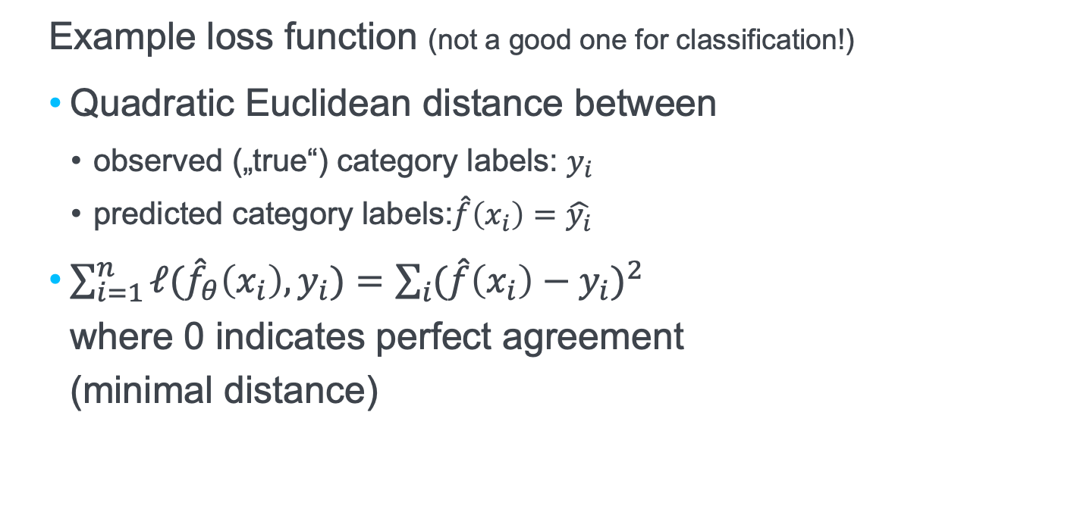
Empirical risk (cost function / loss function)
Example loss function (not a good one for classification!)
Quadratic Euclidean distance between
observed („true“) category labels: $y_{i}$
predicted category labels:$\hat{f}\left(x_{i}\right)=\hat{y_{i}}$
$\sum_{i=1}^{n}{ℓ({\hat{f}}_{θ}\left(x_{i}\right),y_{i})}=\sum_{i}{{(\hat{f}\left(x_{i}\right)−y_{i})}^{2}}$ where 0 indicates perfect agreement (minimal distance)

Slide 25
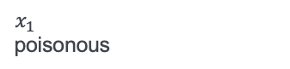
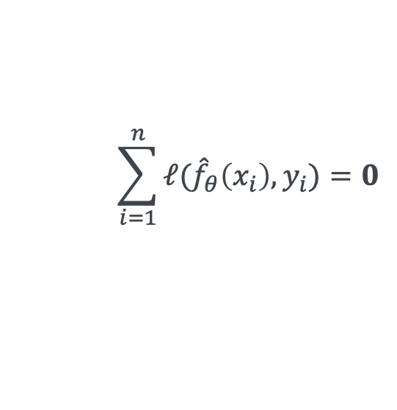
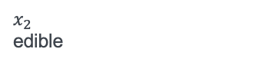
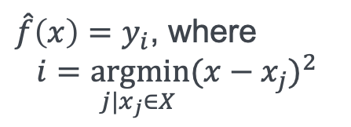
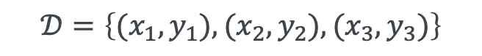
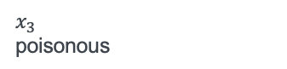
1-nearest neighbor: Lazy learning (represent in vector space)
Black gills
$$𝒟=\left\{(x_{1},y_{1}),(x_{2},y_{2}), (x_{3},y_{3})\right\}$$
1
yes
$x_{1}$
poisonous
$\hat{f}\left(x\right)=y_{i}$, where
$\underset{ j|x_{j}∈X}{i=argmin}{{(x−x_{j})}^{2}}$
$$\sum_{i=1}^{n}{ℓ({\hat{f}}_{θ}\left(x_{i}\right),y_{i})}=0$$
0
no
$x_{3}$
poisonous
$x_{2}$
edible
Bell-shaped
0
no
1
yes

Slide 26
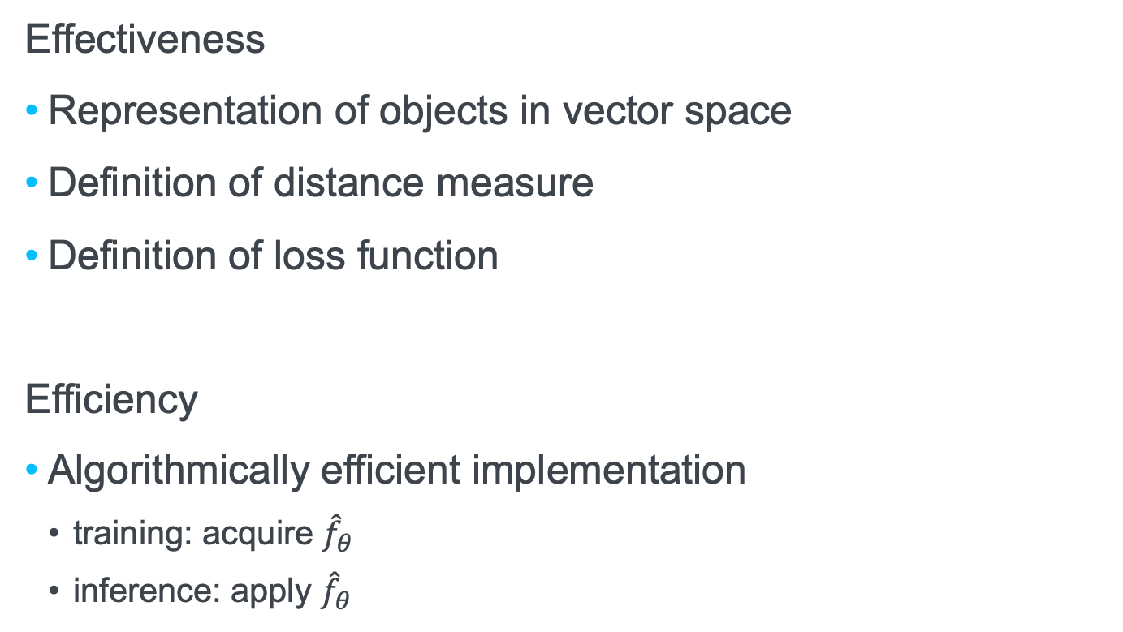
„Ingredients for 1-nearest-neighbor“
Effectiveness
Representation of objects in vector space
Definition of distance measure
Definition of loss function
Efficiency
Algorithmically efficient implementation
training: acquire ${\hat{f}}_{θ}$
inference: apply ${\hat{f}}_{θ}$

Slide 27
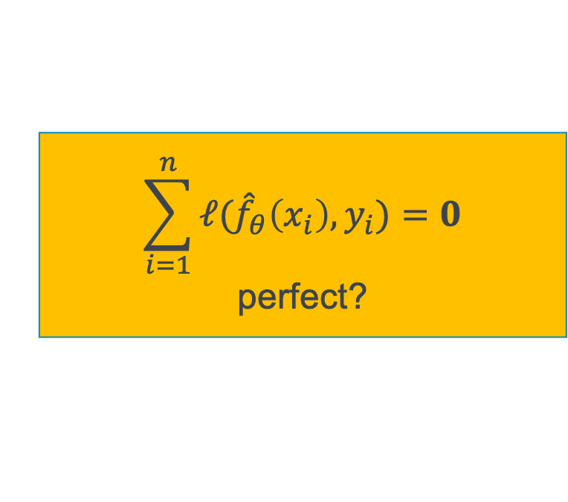

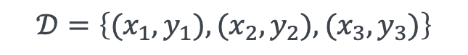
1-nearest neighbor: Lazy learning (represent in vector space)
Black gills
$$𝒟=\left\{(x_{1},y_{1}),(x_{2},y_{2}), (x_{3},y_{3})\right\}$$
1
yes
$x_{1}$
poisonous
$\hat{f}\left(x\right)=y_{i}$, where
$\underset{ j|x_{j}∈X}{i=argmin}{{(x−x_{j})}^{2}}$
$$\sum_{i=1}^{n}{ℓ({\hat{f}}_{θ}\left(x_{i}\right),y_{i})}=0$$
0
no
$x_{3}$
poisonous
$x_{2}$
edible
$$\sum_{i=1}^{n}{ℓ({\hat{f}}_{θ}\left(x_{i}\right),y_{i})}=0$$
perfect?
Bell-shaped
0
no
1
yes

Slide 28
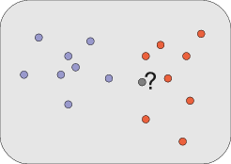
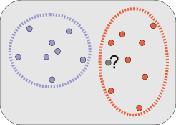
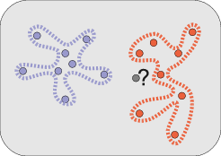
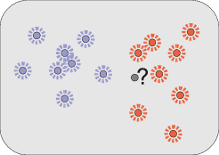
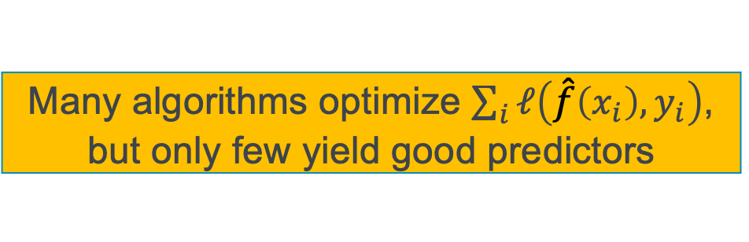
Overfitting
Many algorithms optimize $\sum_{i}{ℓ\left(\hat{f}\left(x_{i}\right),y_{i}\right)}$, but only few yield good predictors
Labelled training data provides only examples
Generalization required
How to classify new/unseen data?
Overfitting:
Not enough generalization
Bad performance on new data
„Learning by heart“ (extreme case: using an object ID)

Slide 29

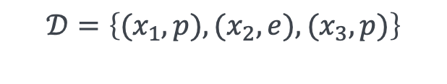
k-nearest neighbor (kNN): Lazy learning (represent in vector space)
Black gills
$$𝒟=\left\{(x_{1},p),(x_{2},e), (x_{3},p)\right\}$$
1
yes
$x_{1}$
poisonous
$$x$$
avoids overfitting
0
no
$x_{3}$
poisonous
$x_{2}$
edible
Bell-shaped
0
no
1
yes
Notes:
what is the loss

Slide 30
Example
Decision: k = 1: classified as „+“, k = 5: classified as „−“
Decision set for k = 1
Decision set for k = 5
Examples for classes „+“ and „-“

Slide 31
The parameter k
k „too small“: ⇒ Too little generalization: high sensitivity regarding outliers
k „too large“: ⇒ too much generalization: many objects from different clusters (classes) included in the decision set.
„middle range“ k: highest classification quality, often 1 << k < 10
Decision set for k = 1
x
Decision set for k = 7
Decision set for k = 17
x: object to classify

Slide 32
Selection of the parameter k
Probing different parameters: k= 1, 2, 3, …
For each k: determine classification error:
Either on the training set
Or via x-fold cross validation
Use best k for classification

Slide 33
Decision rules
Default rule choose the majority class of the decision set
Weighted decision rules
Weigh the training examples in the decision set
w.r.t. the distance to the object to classify
w.r.t. the distribution of the class (which might be skewed!)
Example: class A: 95 %, class B 5 % Decision set = {A, A, A, A, B, B, B} default rule ⇒ A, weighted rule ⇒ B
w.r.t. a cost function (predicting A as B is less tolerable than vice versa)

Slide 34
Discussion: k-nearest neighbour
Advantage:
Only requires training data as an input
High classification accuracy in many applications
Incremental: model does not need to be adapted
Variations for the prediction of numerical values exist
Disadvantage:
Inefficient during classification (runtime)
Does not generate explicit knowledge about classes

Slide 35
Validation and Evaluation

Slide 36

Evaluation using Labeled Data
apple
orange
apple
ML
banana
$$F$$
grape
apple
banana
?
orange
grapes
apple
train
$$\hat{f_{θ}}$$
banana
apple
banana
grapes
orange
grapes
orange
grapes

Slide 37
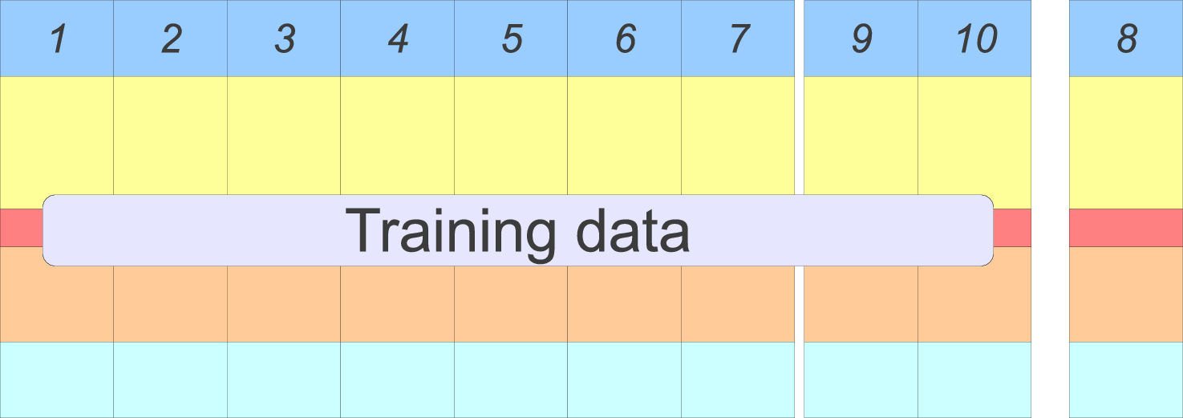
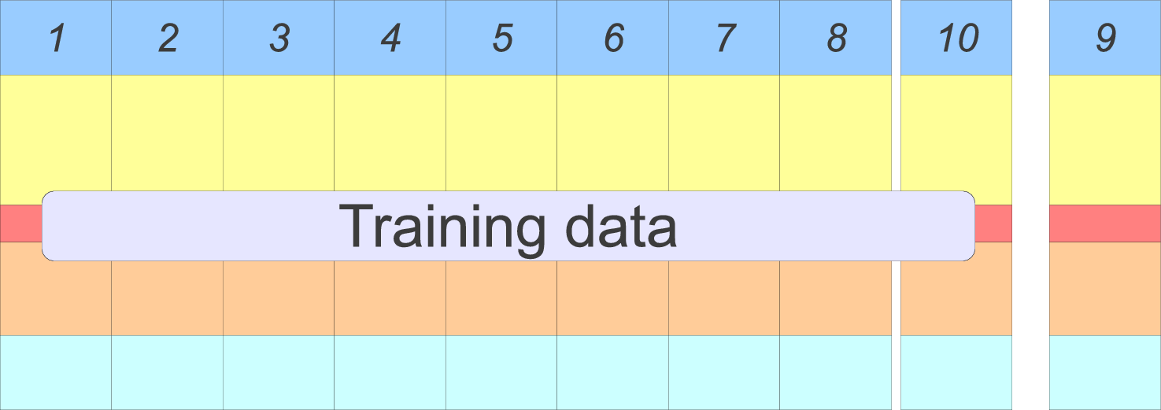
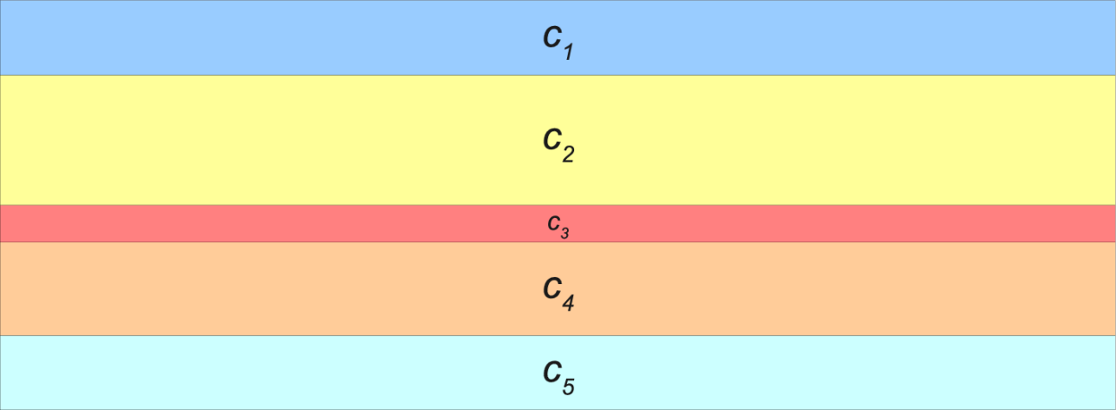
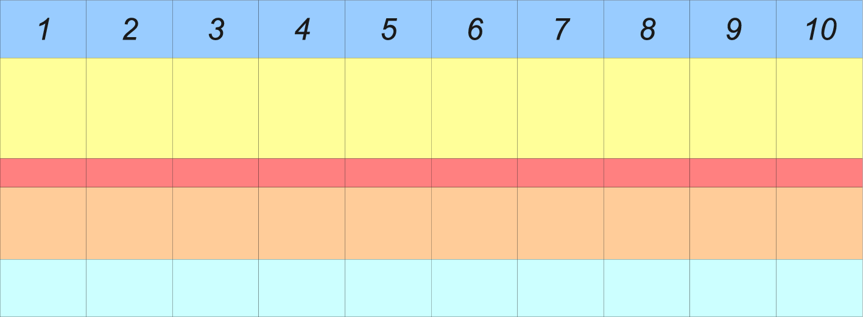

Evaluation Data
Otherwise no chance to detect overfitting
Training data must not overlap with evaluation data !!!
Held-out data
k-fold cross-validation
Split labelled data in equal slices, leave-one out validation
Use average performance (see next slides)
Repeat several times to overcome random sampling
10-times 10-fold cross-validation
Notes:
Bayesian error
heights of people, (height-gender). 1,65m 1,80m; 172,5m; 1,65m; male 1m

Slide 38
Small k: shows sensitivity of hyperparameter choice; Large k: approximates performance

Slide 39

Fighting overfitting when evaluating
Splitting data into three non-overlapping sets
$𝒟_{1}∪𝒟_{2}∪𝒟_{3}=𝒟, 𝒟_{1}∩𝒟_{2}=𝒟_{1}∩𝒟_{3}=𝒟_{2}∩𝒟_{3}=∅$
Train to minimize $\sum_{(x,y)∈𝒟_{1}}{ℓ\left(\hat{f}\left(x\right),y\right)}$
Validate results with $\sum_{(x,y)∈𝒟_{2}}{ℓ\left(\hat{f}\left(x\right),y \right)}$
determine best hyperparameters, e.g. k in kNN
Evaluate results with $\sum_{(x,y)∈𝒟_{3}}{ℓ\left(\hat{f}\left(x\right),y\right)}$
determine how well you do after modeling and optimization
Training data, validation data and evaluation data must not overlap in pairwise intersection

Slide 40
Confusion Matrix
Extend confusion matrix to multiple categories
Metrics for each category:
Recall:
Precision:
F₁: harmonic mean of recall and precision:
 |  | Ground truth
 |  | c₁ | c₂ | c₃ | … | c_{J}
γ | c₁ | correct | error | error |  | error
 | c₂ | error | correct | error |  | error
 | c₃ | error | error | correct |  | error
 | … |  |  |  | …
 | c_{J} | error | error | error |  | correct
Ratio of how many objects in c_{i} have been correctly classified
Ratio of how many objects have been correctly classified as c_{i}
A bit of both ...

Slide 41
Type I vs Type II error

Slide 42
Confusion Matrix
Extend confusion matrix to multiple categories
Metrics:
Globally: Accuracy, 0-1-loss
 |  | Ground truth
 |  | c₁ | c₂ | c₃ | … | c_{J}
γ | c₁ | correct | error | error |  | error
 | c₂ | error | correct | error |  | error
 | c₃ | error | error | correct |  | error
 | … |  |  |  | …
 | c_{J} | error | error | error |  | correct
Ratio of correct decisions

Slide 43
Evaluating a Mushroom Classifier
Example
Three categories: poisonous, edible, psychoactive
Confusion matrix
For „Poisonous“: Recall, Precision, F₁?
Accuracy, 0-1-loss?
 |  | Ground truth
 |  | Poisonous | Edible | Psycho-active | Total
γ | Poisonous | 5 | 1 | 2 | 8
 | Edible | 2 | 10 | 4 | 16
 | Psycho-active | 0 | 0 | 6 | 6
 | Total | 7 | 11 | 12 | 30
micro/macro/weighted

Slide 44

Summary on Evaluation
Evaluation is motivated by application
For example: you care about correct classification,
you do not care whether you could have been almost correct
A loss function is usually not a good evaluation function
As we will see later: A loss function needs to support the determination of parameters $θ$

Slide 45
Miscellaneous

Slide 46

Variations of the Classification Task
Category types:
Flat vs. hierarchical
Exclusive vs. multiple categories
Function$\hat{f_{θ}}$
Hard vs. soft assignments
Manual provision vs. machine learning
Purpose
Descriptive Modelling
Explain the data
Predictive Modelling
Classify new data
Notes:
Hard/soft = single/multiple class membership

Slide 47
Sources
Optical recognition of fruits: http://de.ids-imaging.com/case-studies.html
Document classification: http://www.ndm.net/opentext/capture-and-recognition/capture-center
Email spam: http://www.gfi.com/blog/spam-emails-bringing-excitement-1978/
Amanita muscaria: http://commons.wikimedia.org/wiki/File:Amanita_muscaria_3_vliegenzwammen_op_rij.jpg, CC-BY-SA 3.0-nl, Onderwijsgek
Lactarius indigo: http://commons.wikimedia.org/wiki/File:Lactarius_indigo_48568.jpg, CC-BY-SA 3.0, Dan Molter

Slide 48

IPVS
Steffen Staab
Steffen.staab@ipvs.uni-stuttgart.de
To be defined
ipvs.uni-stuttgart.de/departments/ac/
Analytic Computing, IPVS
Universitätsstraße 32, 50569 Stuttgart

